Slide 2
7.2 Billion people in the world. Every 8 seconds another person is born.

Slide 3
Emerging Middle Class
4.9
Billion by 2030
3.2
Billion by 2020
1.8
Billion in 2009

Slide 4
Leading to Shortages of Key Resources

Slide 5
What is the solution?

Slide 6
Deployment of Proven Technologies which will:

Slide 7
Clean & conserve water

Slide 8
Efficiently Produce, Conserve, Manage and Store Energy

Slide 9
Clean and Protect the Environment

Slide 10
Produce and distribute food more efficiently

Slide 11
Provide Medical Services and Public Safety

Slide 12
How do we connect these technologies to the people who need them most?

Slide 14
Definition:
Global Technology Expo
for Deployment Demonstration
A central place where many different technologies and projects utilizing and deploying those technologies will be demonstrated. It will be a place where those with problems and those with solutions will be able to meet and develop ways to scale the solutions globally.

Slide 15
Why GTED2
is Unique

Slide 16
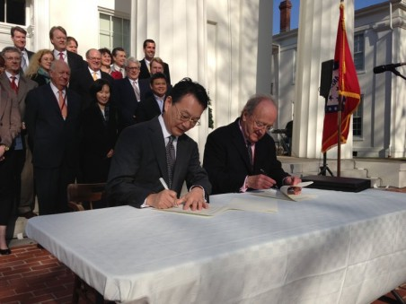
CdM and P80 Sign Little Rock Accord
Club de Madrid
P80 Group Foundation
Little Rock Accord
A key outcome of the meeting was the Little Rock Accord which provided for the Club de Madrid to join forces with the P80 Group and others to form a joint implementation Task Force. This Task Force works with technology companies, institutional investors, multilateral lending institutions, foundations, non-governmental organizations (NGOs), government leaders, and other corporate private sector participants to encourage managers of over $20 trillion of pension and sovereign wealth fund assets to consider increasing their investments for technology deployment to address the growing resource shortages.

Slide 17
Leads to creation of GTED2
Club de Madrid
P80 Group Foundation
Little Rock Accord
LR Accord Task Force
GTED2
The ongoing work towards implementation of the Little Rock Accord includes the planning and development of GTED2, the development of Global Solutions Summits and Reunions.
These efforts involve the participants of the Little Rock Accord proceedings and others who have since joined the Task Force to provide Strategic and Advisory Support.

Slide 18
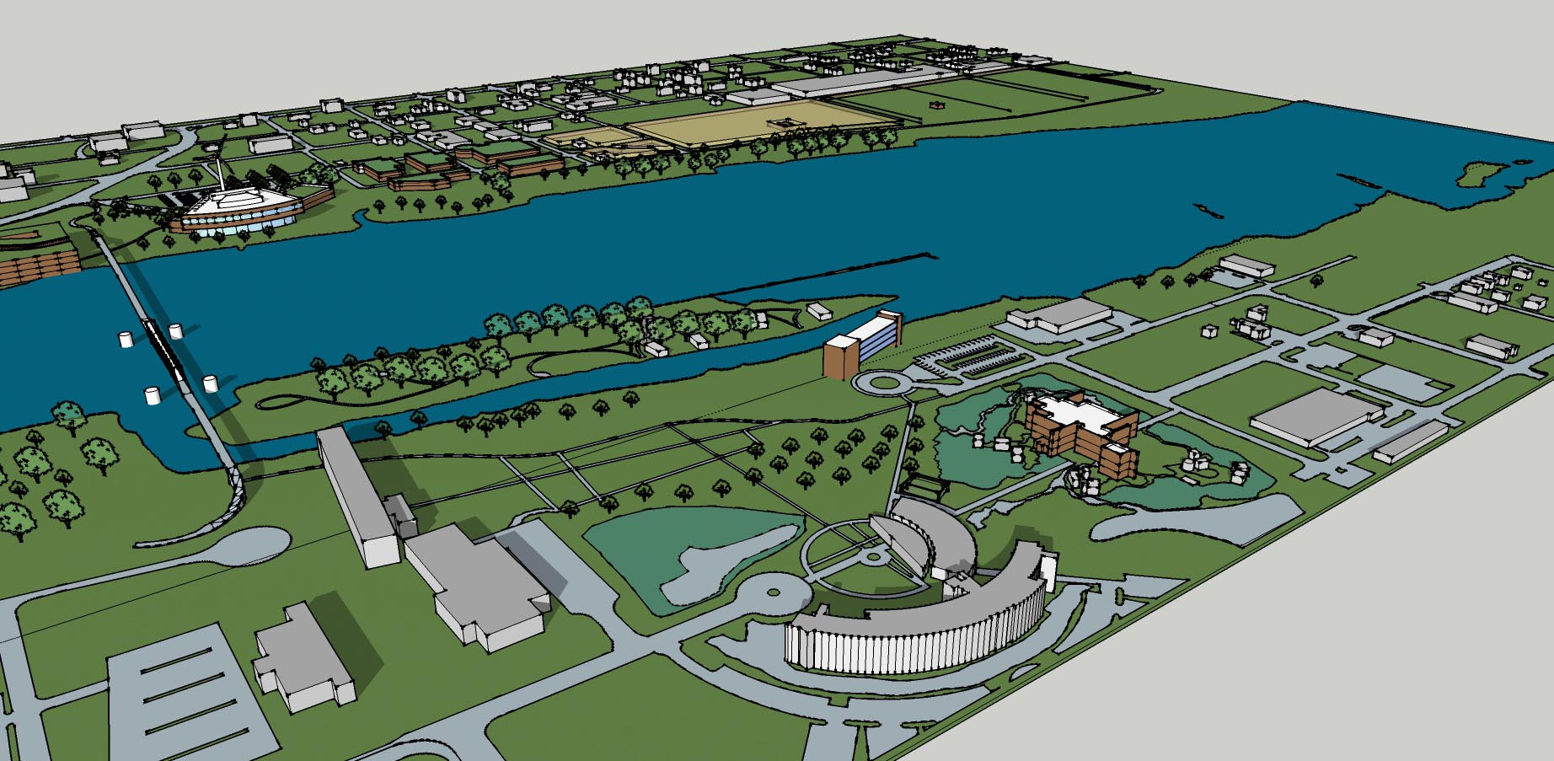
Why GTED2 is unique and needed
While there are several Technology Parks Globally there is no Center focused on deployment of problem solving technologies and projects.
There is no Center which tells the story of who is doing what to solve global problems or what successful models for problem solving have been developed.
There is no Center focused on pulling together a problem-solving network of existing organizations into collaboration on a global scale to solve problems using a multiplier effect.

Slide 19
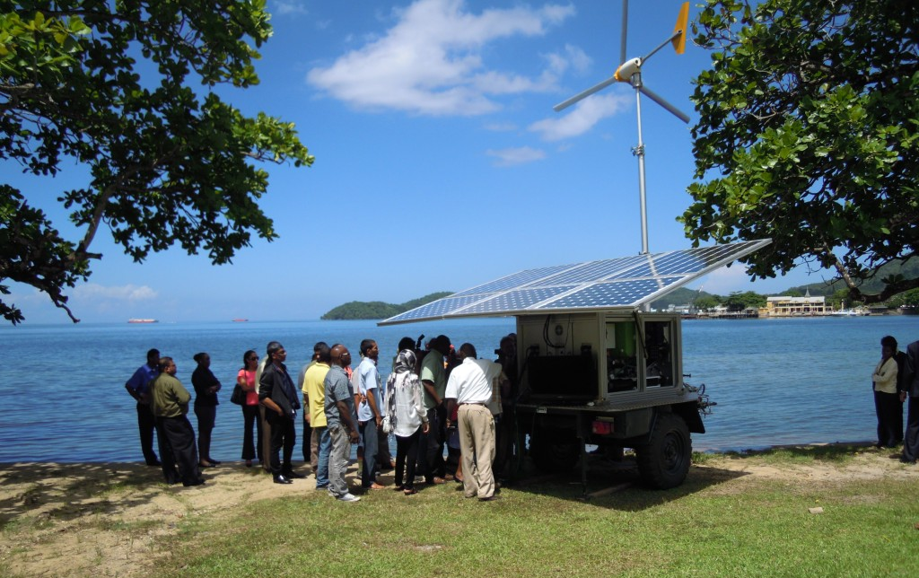
Centers on deployment of technology

Slide 20
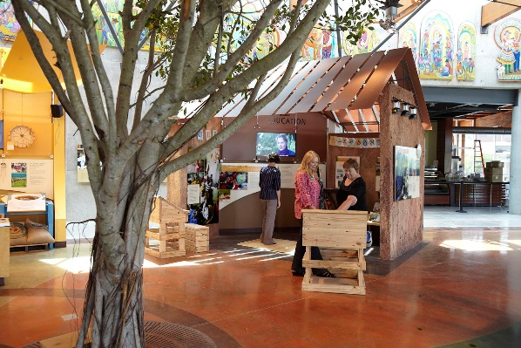
Examples of solving global problems

Slide 21
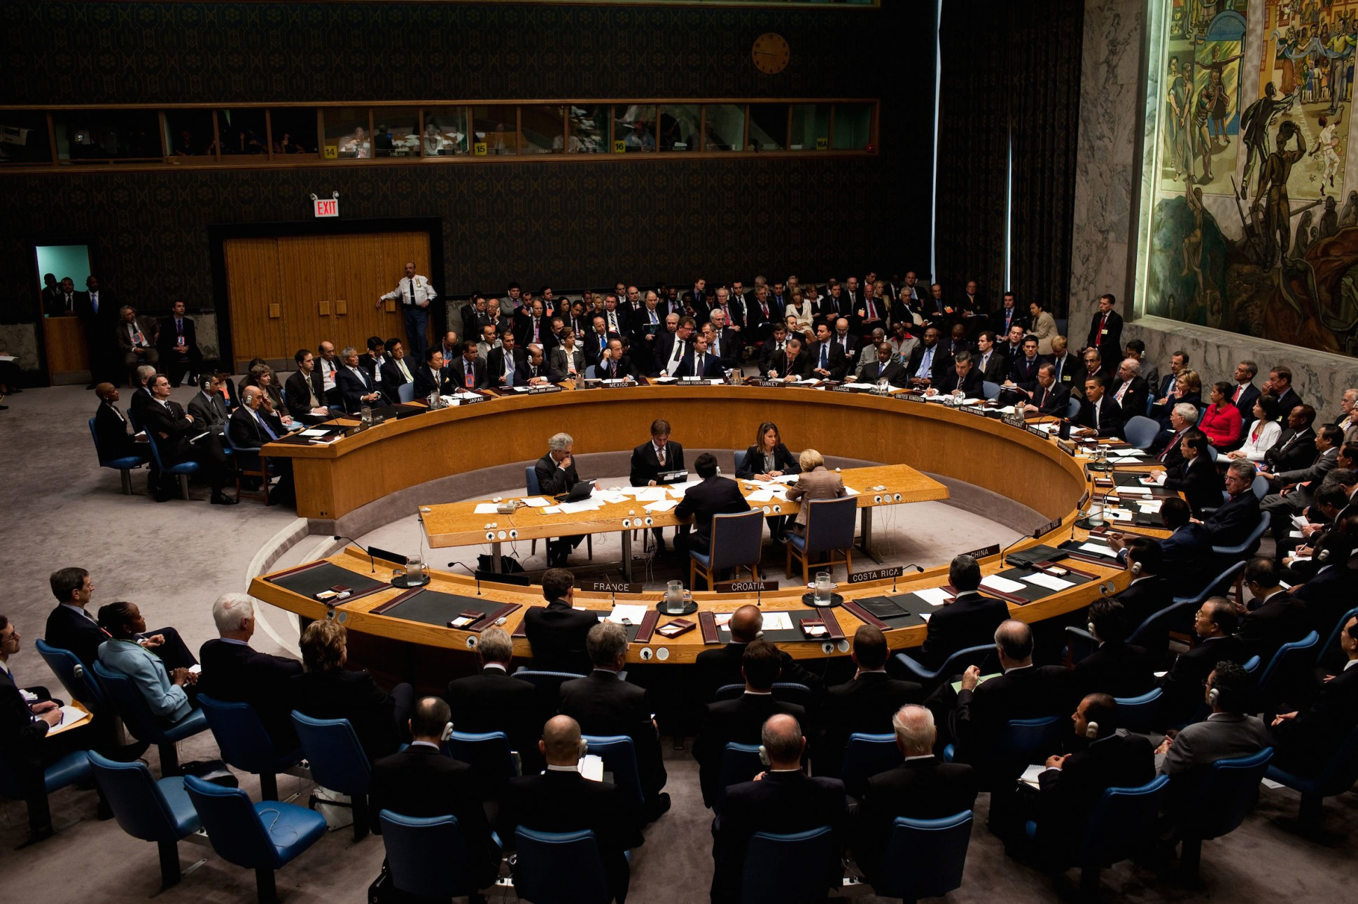
Network of collaboration

Slide 22
How will it work?

Slide 23
Financing and Sales Channels

Slide 24
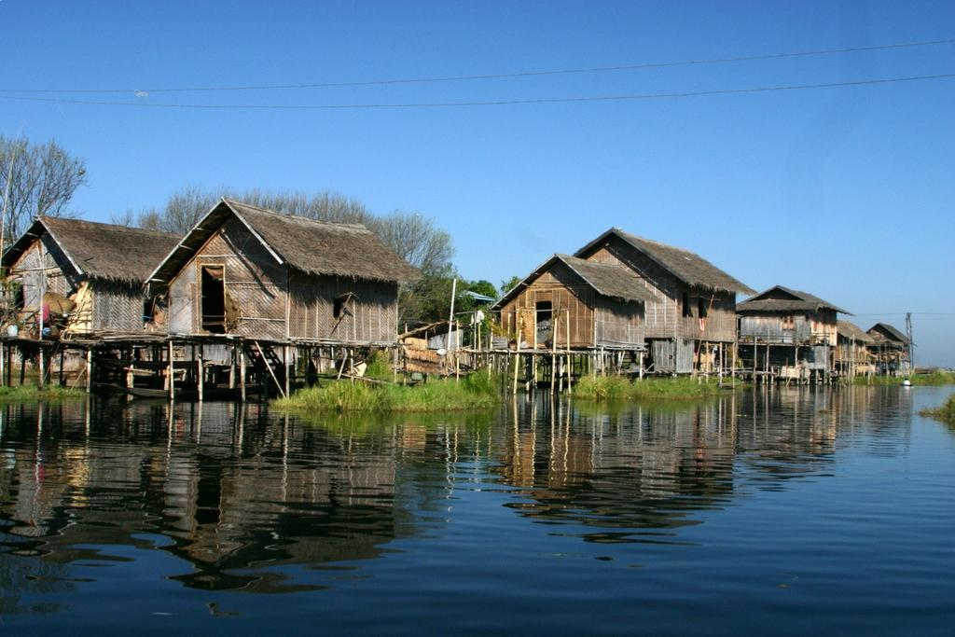
Developing World Component

Slide 25
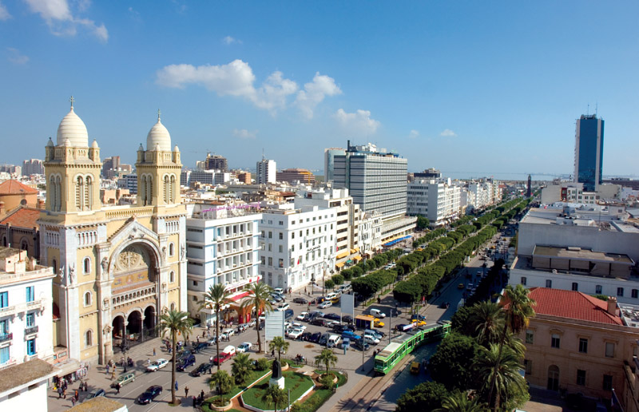
Cities, Tribal Areas & Island States Component
Notes:
Tunis, Tunisia

Slide 26
Corporate Sustainability Component

Slide 27
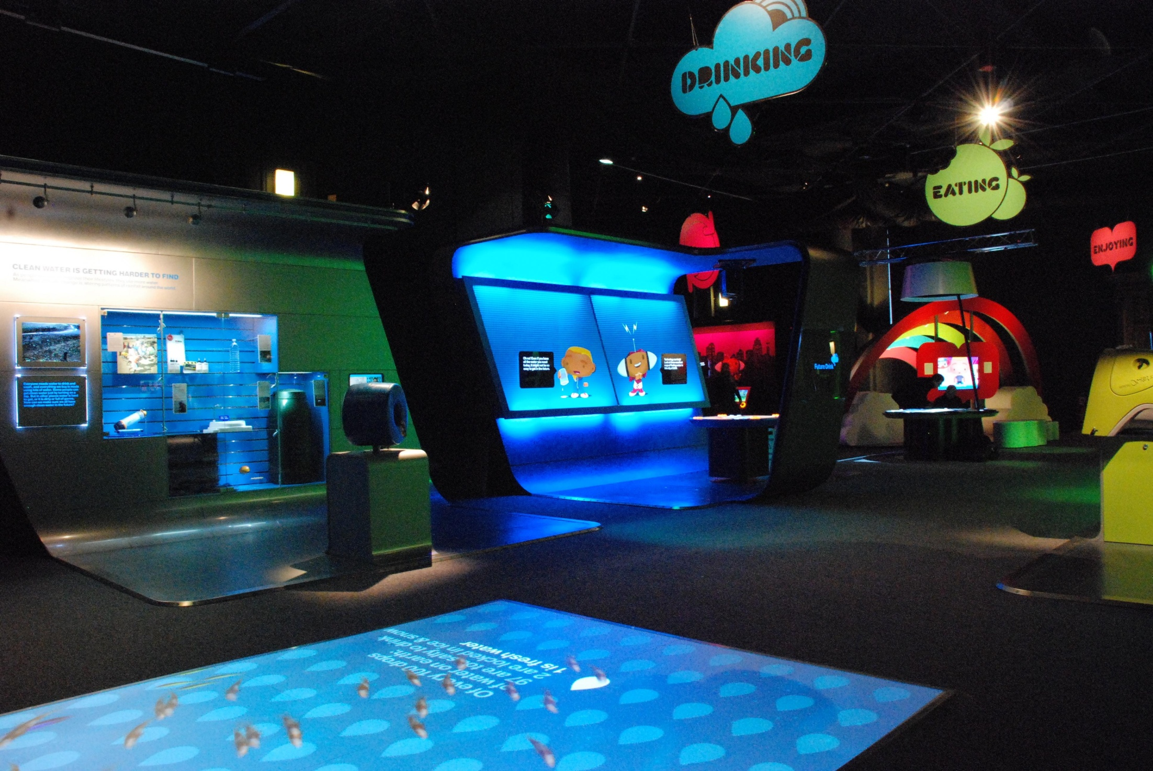
Foundation and NGO Museum and Library Component

Slide 28
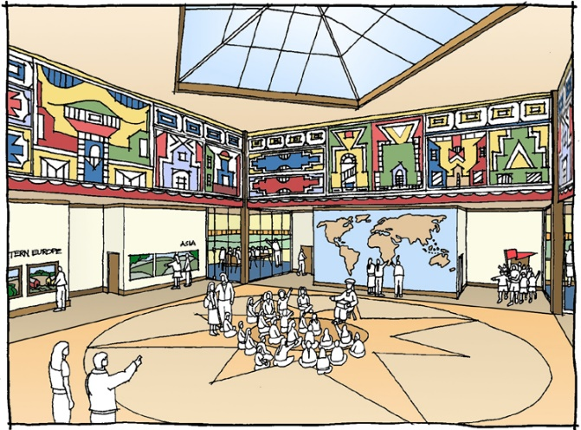
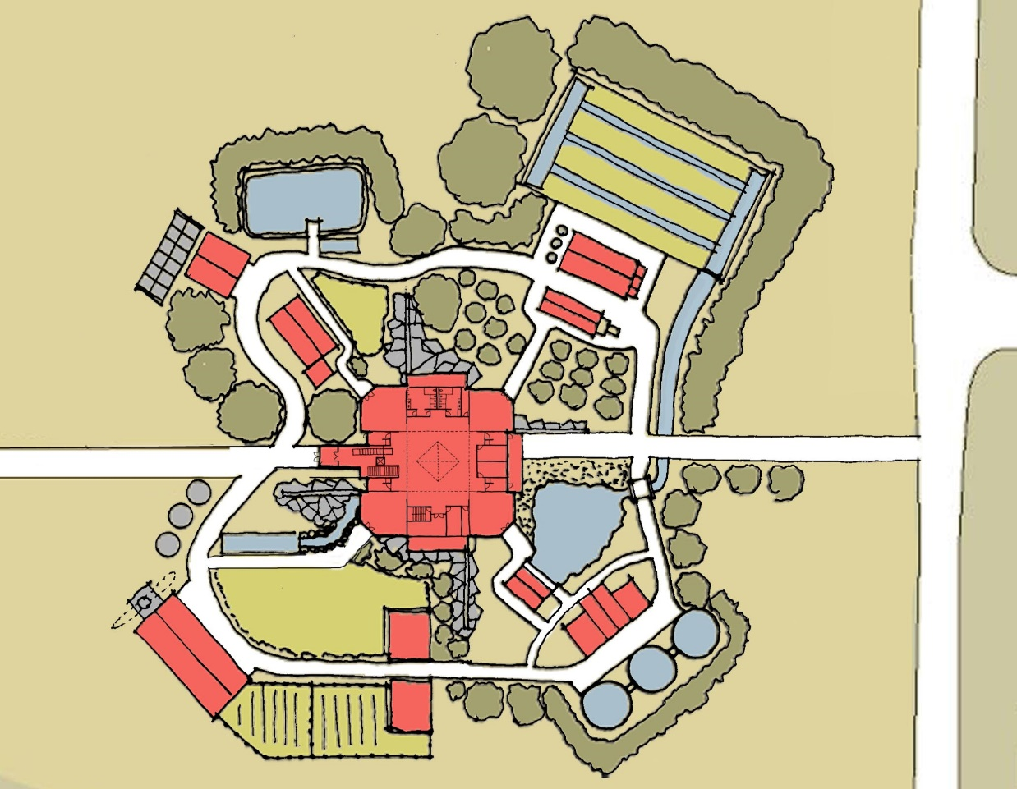
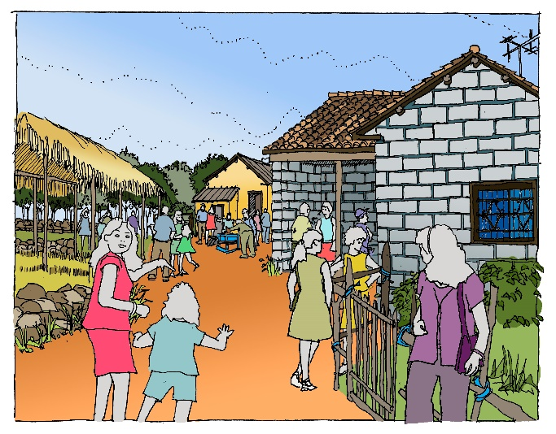
Global Solutions Institute
B: Global Solutions Institute
Rwanda
India
Belize
Vietnam

Slide 29
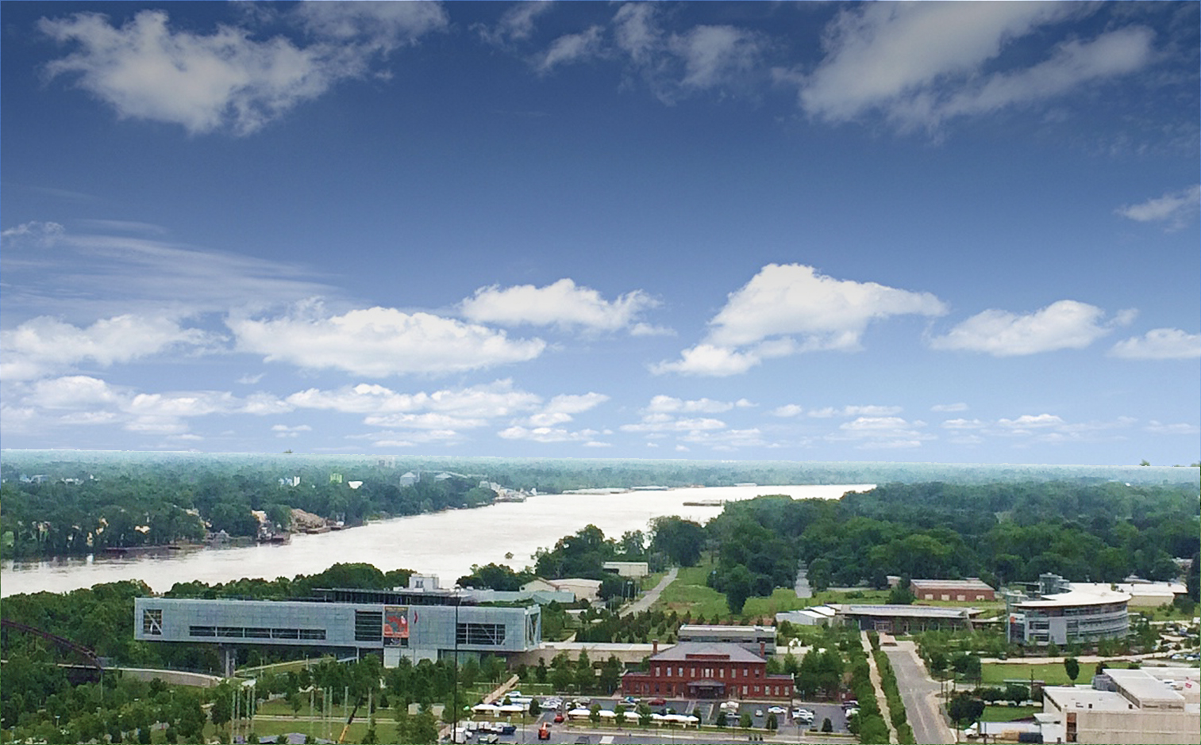

Slide 30
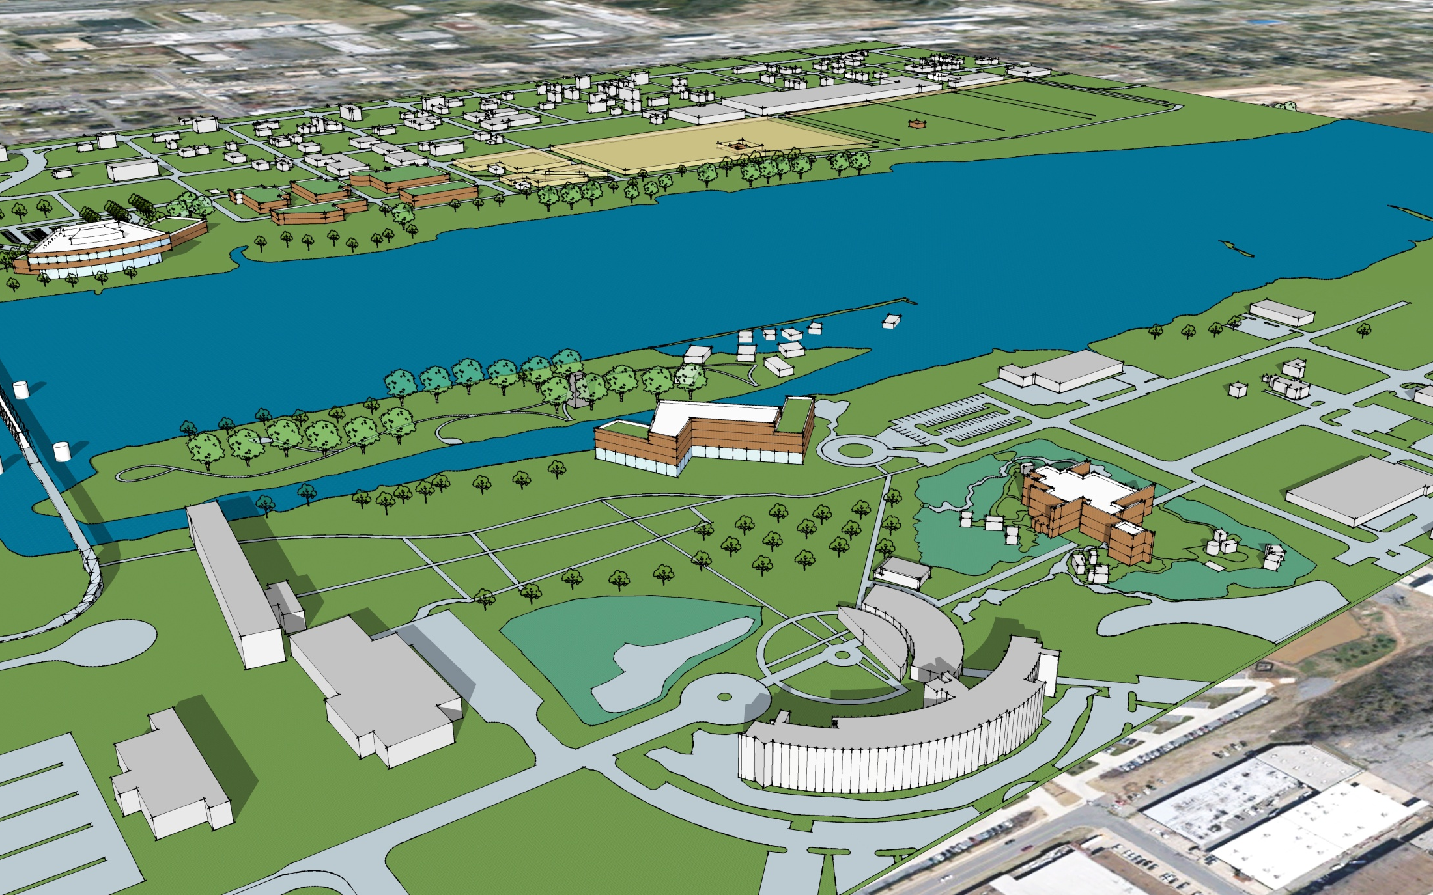

Slide 31
Phase A: GTED2 Orientation Facility and Island States

Slide 32
Phase A: GTED2 Island States
7
6
5
9
8
2
3
1
10
4
8
AQUACULTURE
FLOOD RESISTANT HOUSING
MICRO GRID ELECTRICAL SYSTEM
CELL PHONE BANKING
SOLAR PANEL TECHNOLOGY
WIND POWER TECHNOLOGY
RUN IN RIVER HYDRO
AGRICULTURAL/ IRRIGATION TECHNOLOGY
LED TRAIL LIGHTING
WATER FILTRATION FACILITY

Slide 33
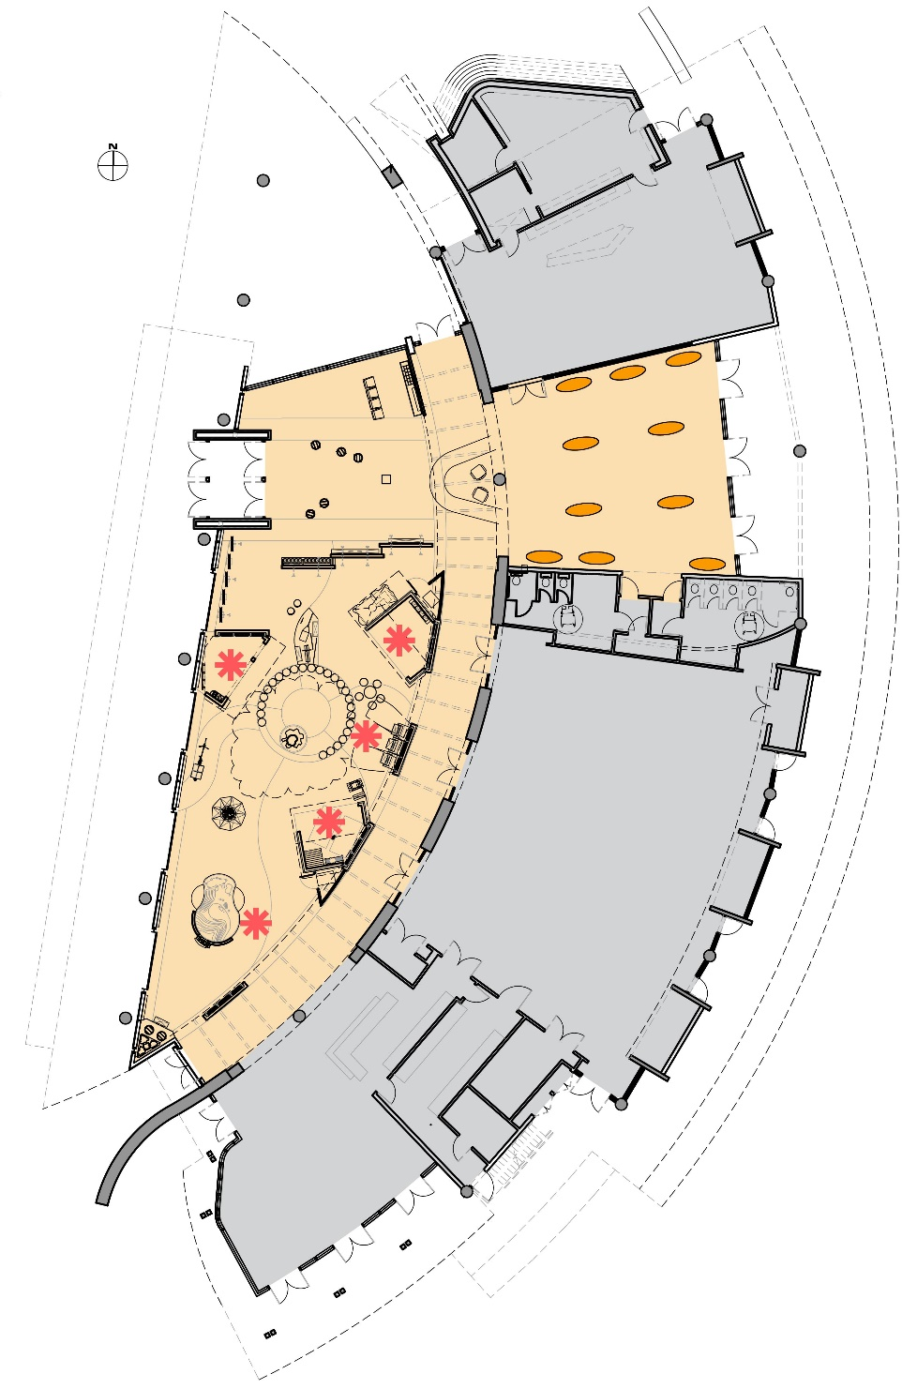
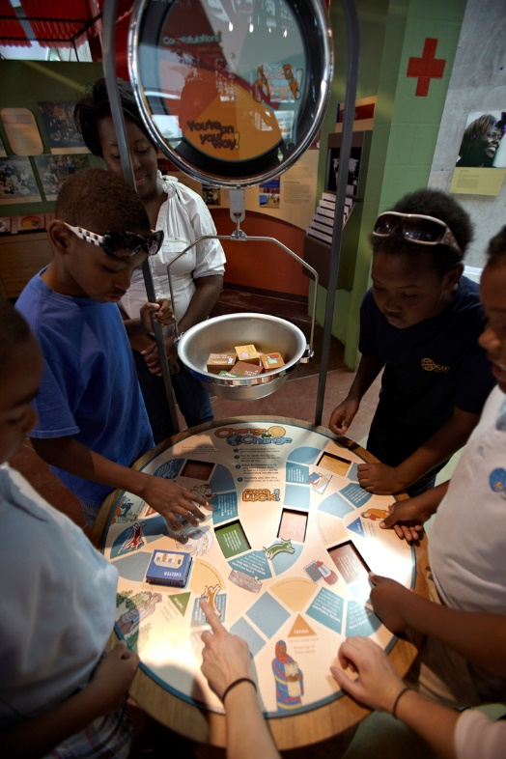
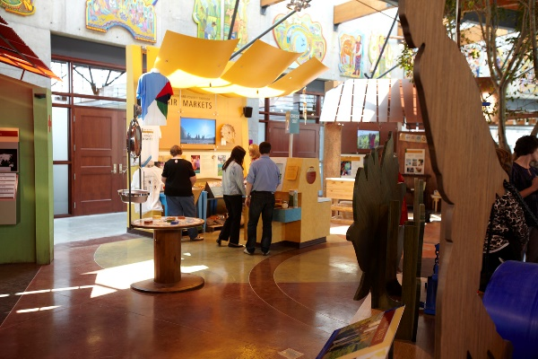
A: GTED2 Orientation Facility
^{Technology Deployment}
^{Micro-grid}
^{High Efficiency Cooling}
Cell Phone Banking/Telemedicine
^{Biomass/Gas Power Plant}
^{Irrigation Efficiency Pump}

Slide 34
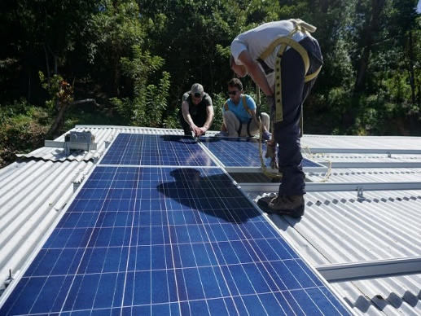
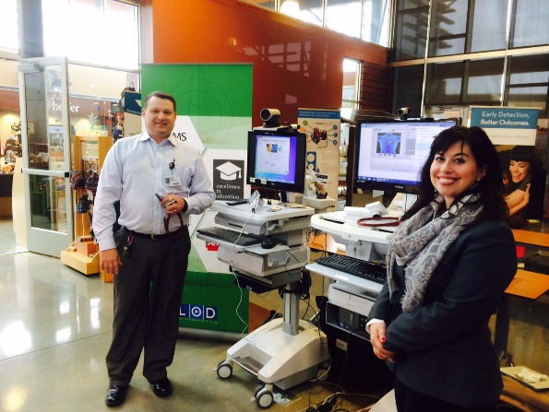
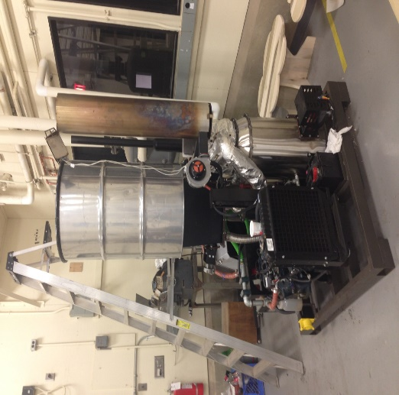
A: GTED2 Orientation Facility
^{Technology Deployment}
^{High Efficiency Cooling}
^{Cell Phone Banking}
^{Biomass Power Plant}
^{Irrigation Efficiency Pump}
^{Technology Showcase}
^{BioFuel/BioEnergy}
^{CleanWeb/IT}
^{Green Buildings}
^{Lighting/Energy Efficiency}
^{Smart Grid}
^{Solar and Wind Power}
^{Sustainable Agriculture}
^{Transportation}
^{Waste Management}
^{Water}

Slide 35
A: GTED2 Orientation Facility
^{Technology Deployment}
^{Energy Management Controls}
^{High Efficiency Cooling}
^{Cell Phone Banking}
^{Biomass Power Plant}
^{Irrigation Efficiency Pump}
^{Technology Showcase}
^{BioFuel/BioEnergy}
^{CleanWeb/IT}
^{Green Buildings}
^{Lighting/Energy Efficiency}
^{Smart Grid}
^{Solar and Wind power}
^{Sustainable Agriculture}
^{Transportation}
^{Waste Management}
^{Water}
^{GTED2 Orientation}

Slide 36
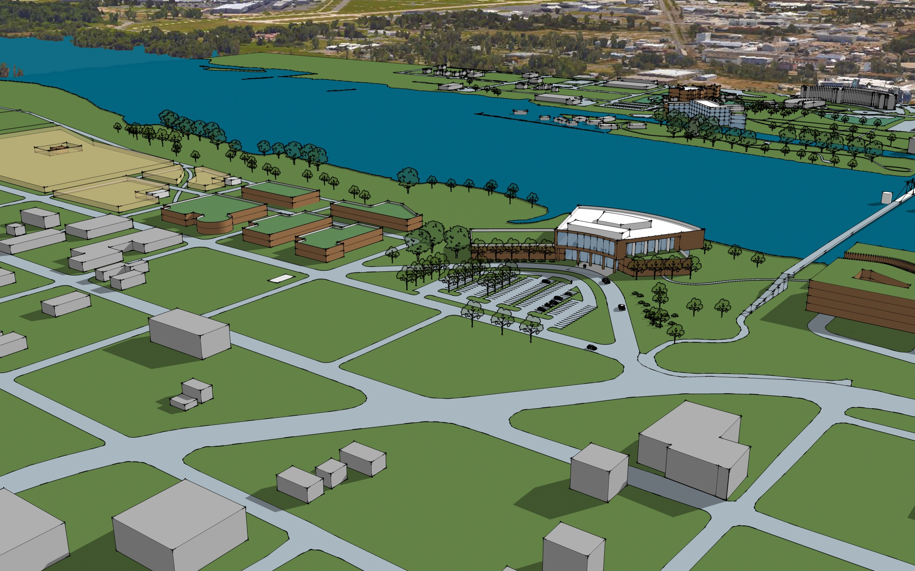
12
11
9
13
10
8
7
14
Urban Technology Deployment Center
Club de Madrid/P80 Technology Finance Institute
Outdoor Urban Technology Deployment Center
Global Technology and Conference Center
Marketing Center and Liaison Offices
Rural Community Country Technology Exhibits
Traveling GTED2 & Marine Technology Deployment Barge
Parking Deck/River Trail

Slide 37
Your support
is needed

Slide 38
Future GTED2 Satellite Centers

Slide 39
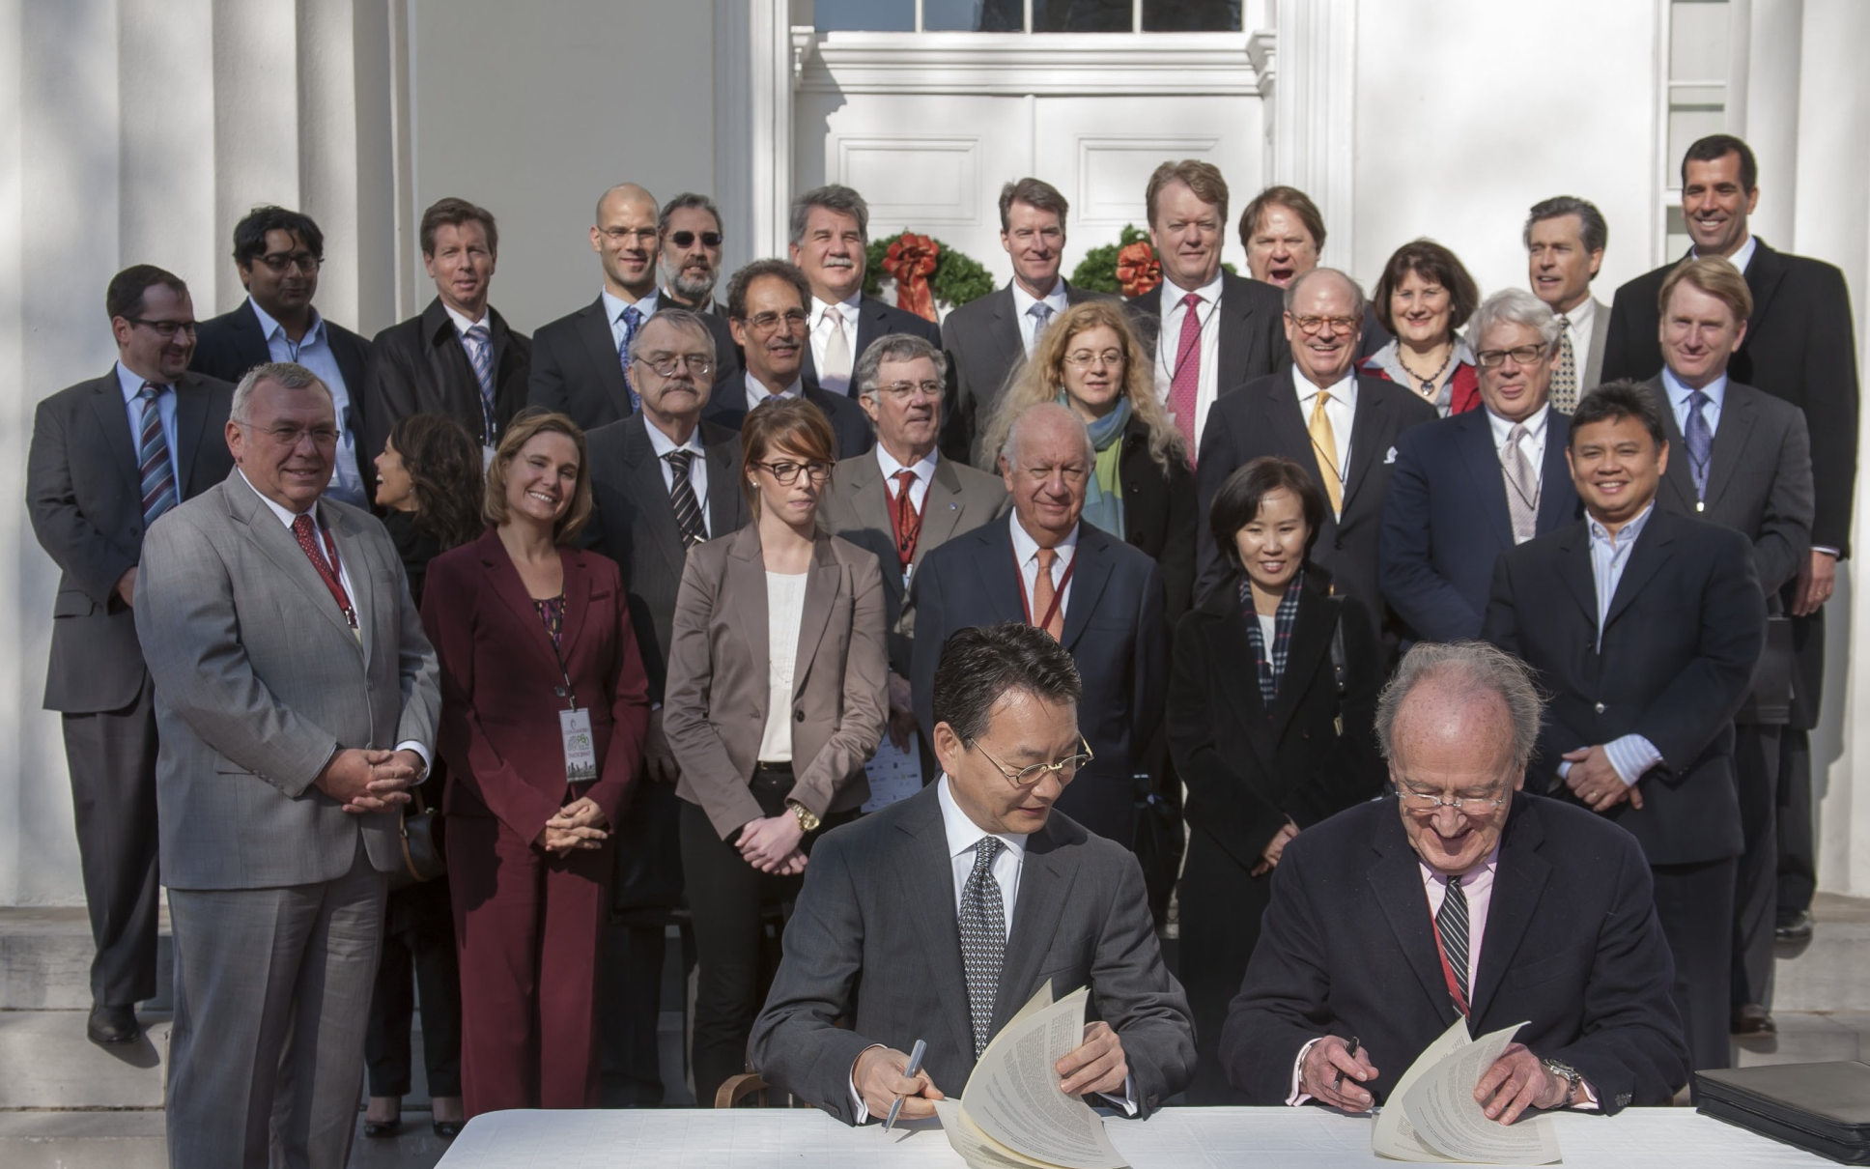

Slide 40
Thank You

